Slide 1
An Introduction to ISACA’s Chapters

Slide 2

What Is ISACA?
Founded 1969
195,000+ Members
Originally the EDP Auditors Association — now a leading global nonprofit association serving IT and IS professionals worldwide.
Professionals in audit, cybersecurity, risk, governance, and digital trust across every major region.
Global Certifications
CISA, CISM, CRISC, CDPSE, and more — industry-recognized credentials that define careers.

Slide 3
What Is an ISACA Chapter?
Chapters are local, member-led organizations that bring ISACA's mission to life at the community level. They are the primary way members experience ISACA in their day-to-day professional lives.
230 Chapters Worldwide
Membership Is Flexible
Spanning Africa, Asia, Europe, Central America, North America, South America, and Oceania.
Members may join any ISACA chapter or no chapter (and remain an "At-Large" member of ISACA Global only).

Slide 4
The Chapter's Core Mission
Chapters serve as the local face of ISACA — delivering education, networking, and professional development to members in their region.
Education
Community
Advocacy
Local training events, webinars, and certification prep courses that keep members current and credentialed.
Networking, mentorship, and peer support that connects IS/IT professionals across local markets.
Promoting best practices and digital trust — lobbying and recommending standards to advance the IS/IT industry locally.

Slide 5
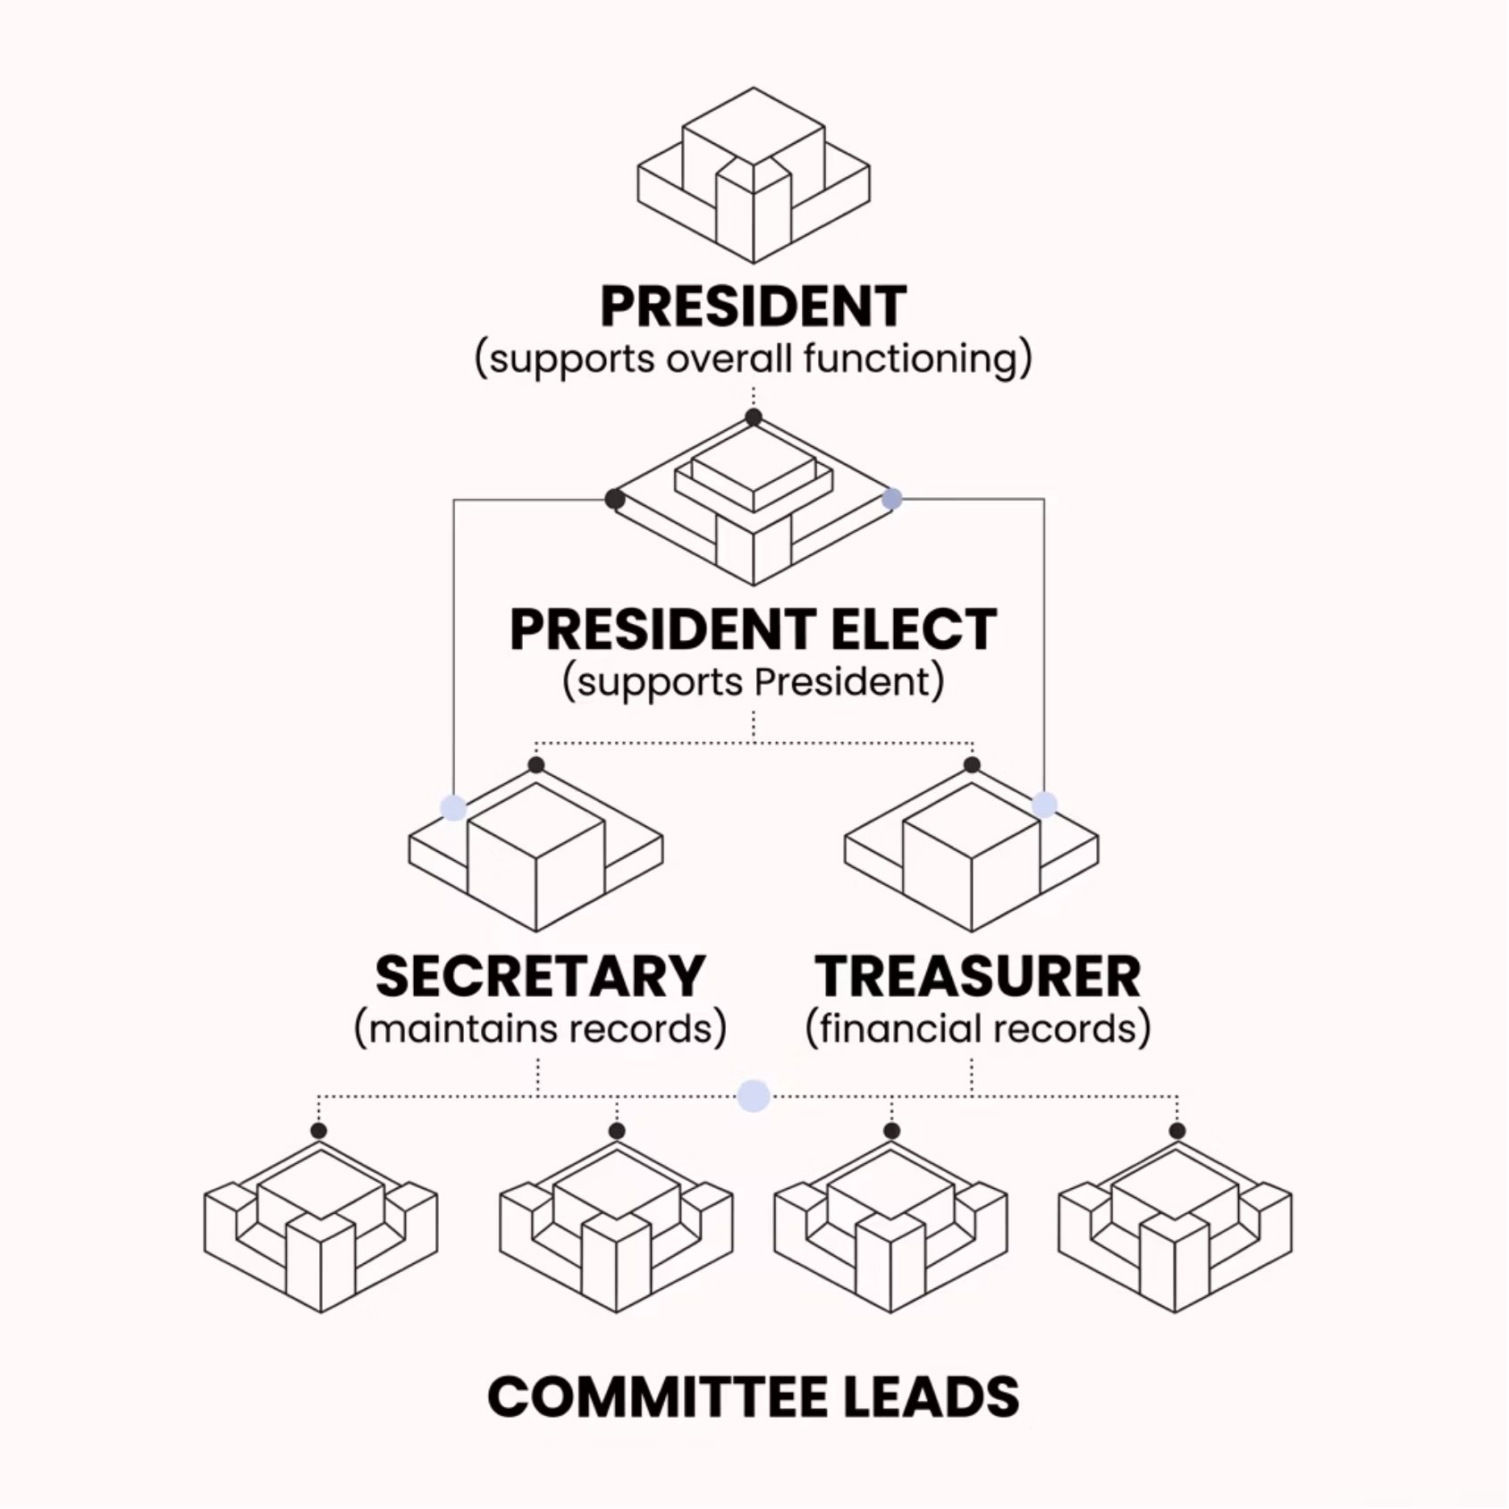
How Chapters Are Governed
Volunteer Board of Directors
Each chapter is led by elected volunteer officers: President, President Elect or Vice-President, Secretary, Treasurer, and committee leads. Officers may vary by chapter, but generally, each chapter has these positions.
The President serves as the chapter's official representative to ISACA Global Headquarters, communicating chapter needs and concerns.
Chapters submit annual reports and financial audits to maintain
their charter in good standing.

Slide 6
What Chapters Offer Members
Up to 72+
25%
230+
Free CPE Credits
Exam Discount
Local Chapters
Available annually to help members maintain their certifications and professional standing.
Up to 25% off CISA, CISM, CRISC, CGEIT, and other exam registrations for members.
Worldwide venues for networking, mentorship, volunteer leadership, and career development.

Slide 7

The Chapter–HQ Relationship
A Partnership Built on Alignment
Chapters operate semi-autonomously but align with ISACA's global standards, bylaws, and brand guidelines. Neither side succeeds without the other.
ISACA HQ provides resources, tools, the Engage online platform, and chapter awards recognition
Staff at HQ support chapters guide chapters through program needs, governance, compliance, and other operational and support needs
Chapter presidents attend leadership conferences to stay aligned with global strategy

Slide 8
The Chapter Affiliation Agreement
The legal foundation of the chapter–ISACA relationship, signed by each chapter and ISACA Global.
The Charter
Performance Standards
Grants official authorization to operate as an independent ISACA chapter within a definedtTerritory — at no fee to the chapter.
4+ board meetings annually, 4+ educational events, elections at least every 2 years, and required reports submitted to ISACA.
Independent Contractors
Brand & IP License
Chapters are legally and financially independent — not agents or subsidiaries of ISACA. Each chapter manages its own affairs.
A limited, revocable, royalty-free license to use ISACA's name, logo, and trademarks for official chapter purposes only.

Slide 9
Our Role as ISACA Chapter Experience Staff
Support Chapters
Help volunteer leaders navigate resources, reporting, and compliance — making their work easier and more effective.
Enable Growth
Connect chapters to HQ programs, tools, and best practices so they can deliver more value to local members.
Be the Bridge
Translate global strategy into local chapter action — and bring chapter feedback back to HQ. Chapters thrive when staff and volunteers work as true partners toward a shared mission.

